Slide 1

Alabama State Department of Education
Reorganization Plan Update
Alabama State Board of Education Work Session
April 12, 2018

Slide 2
Beginning Organizational Chart – 476 Positions (Excluding DDS)

Slide 3
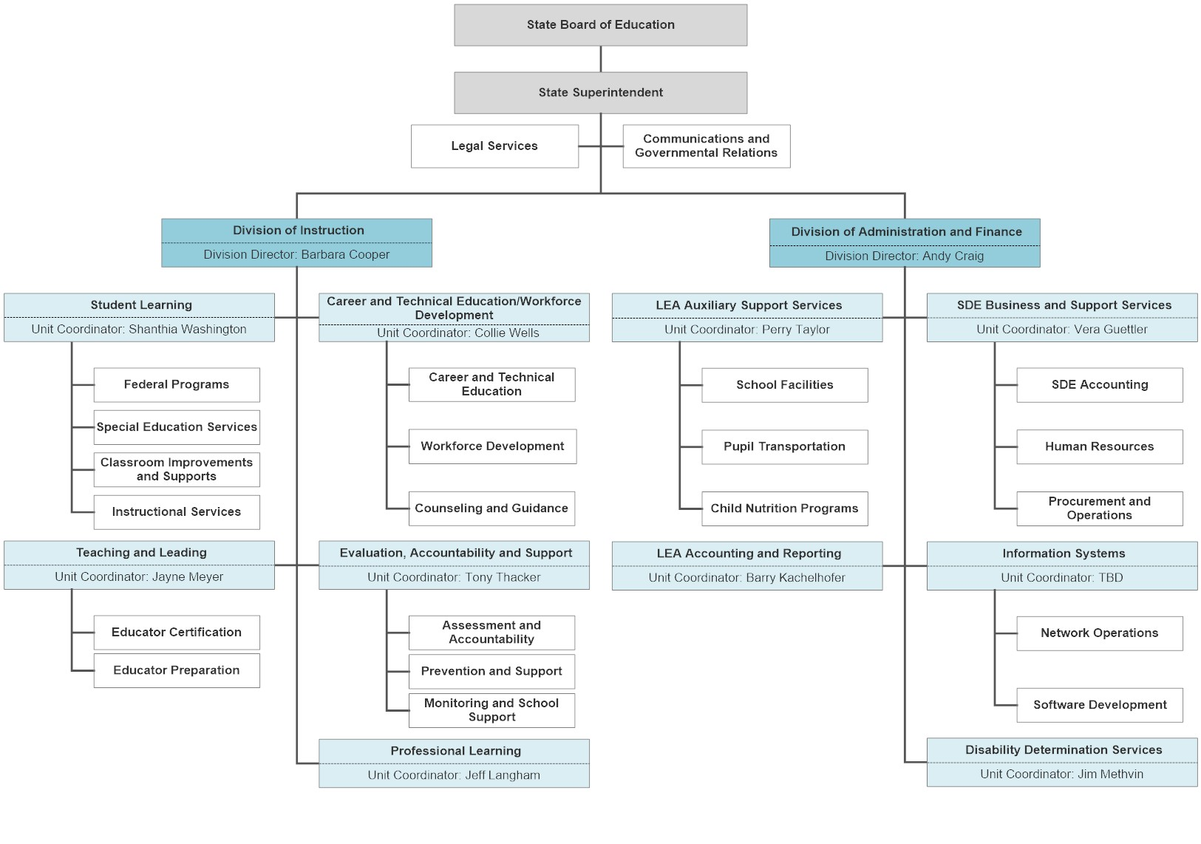
Proposed Organizational Chart – 437 Positions (Excluding DDS)

Slide 4
Exempt Position Summary

