Slide 1
2018 Digital Literacy and Computer Science Course of Study
Notes:
Chairperson, Mr. Billy Wayne Hopkins introduce yourself as the chair of the Digital Literacy and Computer Science Course of Study.

Slide 2
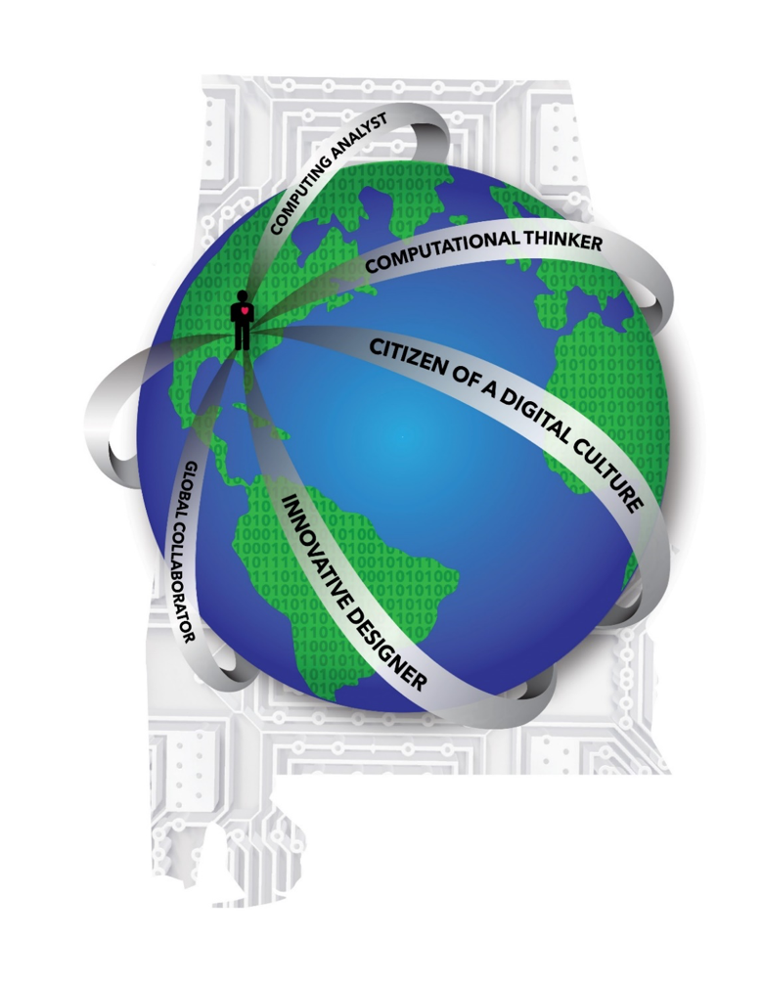
Resources Utilized in the Development of the 2018 Alabama Course of Study: Digital Literacy and Computer Science
The 2009 Alabama Course of Study: Technology Education
2016 International Society for Technology in Education (ISTE) Standards for Students
Computer Science Teachers Association (CSTA) K-12 Computer Science Standards, Revised 2017
K-12 Computer Science Framework
Documents from Other States
Public and Professional Input
Notes:
Mr. Hopkins
The committee and task force researched the 2009 Alabama Course of Study for Technology Education when developing the new course of study. Documents from other states as well as the International Society for Technology Education Standards, the Computer Science Teachers Association K-12 Computer Science Standards that were revised in 2017, and the National K-12 Computer Science Framework were utilized. In November, 2017, the draft version of the Digital Literacy and Computer Science Course of Study was posted on the ALSDE website for public review in order to gather comments for the committee and task force to consider for revision purposes. Content specialists were simultaneously given the draft for scrutiny. All of these resources were utilized in the development of this course of study.

Slide 3
2018 Digital Literacy and Computer Science Course of Study
Course of Study Committee
Course of Study Task Force
Notes:
Mr. Hopkins
Let us begin by reviewing how the course of study committees and task forces are selected. The Course of Study Committee consists of representation from all over the state of Alabama and the School Board districts. As required by the Code of Alabama (1975) Section 16, chapter 35.
Study this and make sure you can answer questions about what the law says.
The Course of Study committee is composed of:
(1) One elementary teacher (Grades K through 6) and one secondary teacher (Grades 7 through 12) from each of the seven congressional districts who are teaching in the course of study areas to be revised during their terms of office;
(2) Four members from the state at-large actively engaged in a supervisory or administrative capacity in the field of education and who are knowledgeable or who have had previous teaching experience in the course of study areas to be revised during their term of office;
(3) Three members who are employees of state institutions of higher learning and who are specialists in the course of study areas to be revised during their terms of office; and
(4) Seven additional members appointed by the Governor, one from each of the seven congressional districts, each of whom shall be either a business or professional representative not employed in the field of education. The Governor's appointees shall have expertise and be actually involved in the course of study field under consideration and shall be confirmed by the Senate.
The committee contained gaps in qualified members for certain content areas. Therefore; a task force was chosen to fill in these gaps.

Slide 4
Chairperson: Billy Wayne Hopkins
Jennifer Alexiou-Ray, Ph.D.
Aimee Bates
Roy Black
Mollie Bounds
Barbara Burchard
Kelli Lane
Timothy Lewis, Ph.D.
Tamara Sanders
Ashley Waring
Lauren Woolley
Vincent Chiaramonte
April Chamberlain
J. Mark Coleman, Ph.D.
Tammy Dunn
Jeff Gray, Ph.D.
Tiffany Goldschmidt, Ed.S.
Notes:
Mr. Hopkins
The Digital Literacy Computer Science Course of Study was developed by the 2018 Digital Literacy Computer Science State Course of Study Committee and Task Force. The Committee and Task Force began work in March 2017 and will submit/submitted the document to the State Board of Education for adoption at the March 2018 meeting.
Chairperson: Billy Wayne Hopkins, Superintendent, Morgan County Board of Education
Jennifer Adrianna Alexiou-Ray, Ph.D., Associate Professor, Instructional Technology and Secondary
Education, University of Montevallo
Aimee Bates, Technology Integration Specialist, Cullman City Board of Education
Roy Black, Teacher, Montgomery Public Schools, Montgomery Public Board of Education
Mollie O’Connor Bounds, Elementary Instructional Specialist of Innovation and Initiative, Madison City
Board of Education
Barbara Burchard, Chief Technology Officer, Elmore County Board of Education
Vincent Joseph Chiaramonte, Teacher, Bumpus Middle School, Hoover City Board of Education
April Praytor Chamberlain, Technology Coordinator, Trussville City Board of Education
J. Mark Coleman, Ph.D., District Technology Instructor, Montgomery Public Board of Education
Tammy P. Dunn, Chief Academic Officer, A+ College Ready
Jeff Gray, Ph.D., Professor, Department of Computer Science, University of Alabama
Tiffany Goldschmidt, Ed.S., Technology Facilitator, Consulting Teacher, Baldwin County Board of Education
Kelli Lane, District Administrator, Technology Integration Coordinator, Hoover City Board of Education
Timothy Darnell Lewis, Ph.D., Associate Professor, Instructional Technology Program Director, Auburn
University Montgomery
Tamara Matthews Sanders, Instructional Technology Specialist, Phenix City Board of Education
Ashley Waring, Teacher, Rocky Ridge Elementary School, Hoover City Board of Education
Lauren Hitt Woolley, Technology Coordinator, Shelby County Board of Education

Slide 5
2018 Digital Literacy and Computer Science Course of Study
Notes:
Mr. Hopkins
Dr. Richardson and State School Board, it is our great pleasure to present to you the 2018 Digital Literacy and Computer Science Course of Study. You will find that this document is designed to help local districts and individual teachers to create effective, challenging, and engaging curricula for every one of their students. I am going to turn this presentation over to Mark Coleman.

Slide 6
Conceptual Framework
The State of Alabama
The Globe
The Student
The Five Content Strands
The Circuit Board and Binary Codes
Notes:
Mark
Introduce yourself to the State School Board.
Let us begin with the Conceptual Framework and its graphic. The graphic representation of this Course of Study contains several elements. The state of Alabama is represented in the background with circuit board to represent hardware. The globe is encircled by the five content strands- computing analyst, computational thinker, citizen of a digital culture, innovative designer, global collaborator- each radiating from the student in the state of Alabama. There is a blank band- intentionally left this way to leave space for the future. Each continent is inscribed with binary code, to represent software and programming.

Slide 7
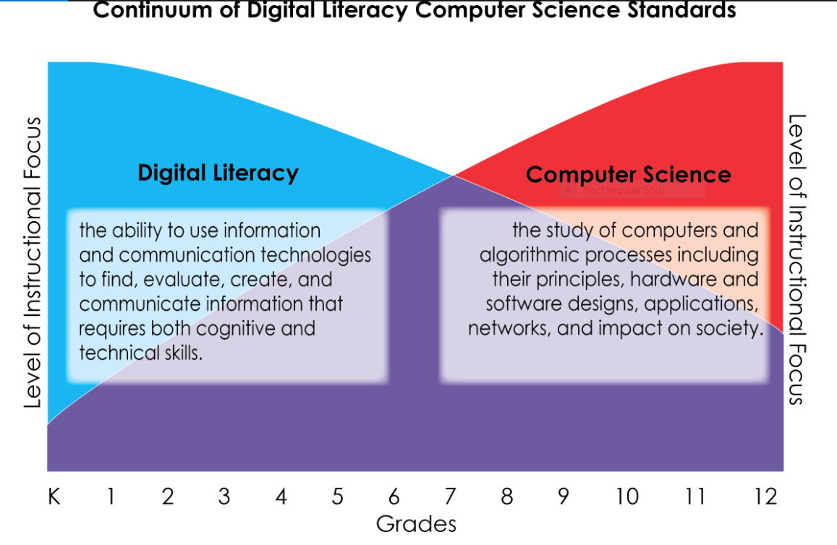
A Vision for K–12 Digital Literacy and Computer Science for Alabama Students
Notes:
Mark
In the early grades in the 2018 Digital Literacy and Computer Science Course of Study, students focus more on digital literacy, which are the skills that students must learn as they are introduced to computer science. In the later grades, the instructional focus transitions from digital literacy toward computer science, but continue by addressing more advanced digital literacy skills. While both focus areas are present along the entire continuum, this graph represents the transition in the level of instructional focus as students progress along the continuum.
For example, a kindergartener learns what digital tools are, an older student learns how they work, and a high school student creates them. Now I am going to turn this presentation over to Ashley Waring.

Slide 8
Recurring Standards for Digital Literacy and Computer Science
Safety, Privacy, and Security
1. Identify, demonstrate, and apply personal safety use of digital devices.
Legal and Ethical Behavior
2. Recognize and demonstrate age-appropriate responsible use of digital devices and resources as outlined in school/district rules.
Impact of Computing
3. Analyze the potential impact of computing.
Systems
4. Identify and employ appropriate troubleshooting techniques used to solve computing or connectivity issues.
Collaborative Research
5. Locate, curate, and evaluate information from digital sources to answer research questions.
Digital Tools
6. Produce, review, and revise authentic artifacts using appropriate digital tools.
Notes:
Ashley, introduce yourself.
Before we begin discussing the different grade-levels, let’s take a look at what the committee found necessary to develop in this course of study. Six of the standards appeared to recur at grade levels along the K – 12 continuum. Tell the SBOE that you are going to pause long enough for them to read the recurring standards
Rather than repeating these standards at multiple grade levels, the committee agreed to outline these standards at the beginning and describe how they would progressively increase in complexity through the grades. If more explanation is needed, refer to page 8 and 9 in the COS. Next, Ashley is going to explain how the content standards that were not “Recurring” were developed from K – 12.

Slide 9
Digital Literacy and Computer Science Content Standard Strands
Computational Thinker
Citizen of a Digital Culture
Global Collaborator
Computing Analyst
Innovative Designer
Notes:
Ashley
After the Recurring Standards, we begin the development of the content standards that were not “recurring”. If you remember from the conceptual framework graphic, we see ribbons around the globe. These phrases on these ribbons represent strands that organize the student’s focus of study for each grade. These phrases were developed with the student in mind, with the end goal stated in each phrase. This COS is intended to help students become computational thinkers, citizens of a digital culture, global collaborators, computing analysts, and innovative designers.

Slide 10
Overview for Grades K–2
Students in Grades K – 2 will meet the following learning goals:
As Computational Thinkers, students will explain how computing is an integral part of our world.
As Citizens of a Digital Culture, students will demonstrate ways to be good digital citizens.
As Global Collaborators, students will collaborate with other learners and contribute ideas to their joint projects.
As Computing Analysts, students will use their growing knowledge of computers to create artifacts systematically and efficiently.
As Innovative Designers, students will undertake challenges and create new ways to address existing problems.
Notes:
Ashley
Before the content standards for each grade are developed, a grade-band overview with the learning goals for each grade-band are given.
In the primary grades (Grades K-2), students begin their formal study of digital literacy and computer science skills. As they are introduced to the digital world, students explore concepts by integrating basic digital literacy skills with simple ideas about computational thinking. At this level, the focus is on learning, with digital tools enhancing the process and student outcomes. Students begin to choose the best tool to meet a need or solve a problem. They discover ways to use digital tools to complete tasks more easily, collaboratively, and efficiently. I am going to allow you to read through the goals for Grades K – 2, before I move on to a specific grade.

Slide 11
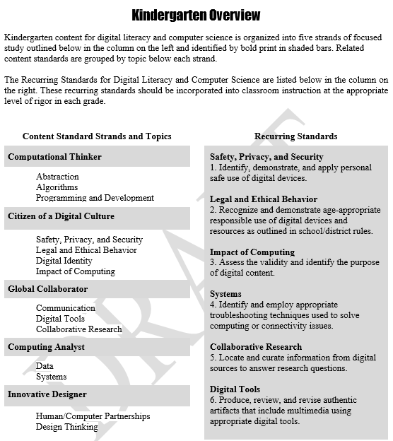
Strands
Topics
Notes:
Ashley
After the grade-band overview, we see each grade-level overview. In each grade-level overview, we see the strands along with the topics which group the related content standards. Notice on each grade-level overview, the recurring standards are listed. On this slide, we see the Kindergarten Overview as an example. Point out the Content Standard Strands:
Computational Thinker, Citizen of a Digital Culture, Global Collaborator, Computing Analyst, and Innovative Designer. Then, the topics under each Strand. Questions that help define and describe the topics are:
Computational Thinker
Abstraction- What are some ways that we can organize information to make it more useful?
Algorithms - What is a sequence?
Programming and Development - What is programming? What is a bug?
Citizens of a Digital Culture
Safety, Privacy and Security - How can you stay safe online? Why is it important to keep your information private? What are passwords and how are they used? Legal and Ethical Behavior - Can you copy what someone on the internet writes? What is appropriate online behavior?
Digital Identity - What is a digital identity? Who has one?
Impact of Computing - How does technology make certain tasks easier? How do computing devices impact people’s lives?
Global Collaborator
Communication- How can we use digital tools to communicate with others locally and globally?
Digital Tools - How can we use digital tools to collaborate with others? What tools are needed to effectively complete a certain task? What is the proper way to type on a keyboard?
Collaborative Research - How do other people address issues? How may authorities and experts be consulted to address common problems? What are ways we can connect with others to create something?
Computing Analyst
Data - What is data and how do we collect it? How can data be organized? How is data saved digitally? Systems - What are the different operating systems on digital devices? How are they different?

Slide 12
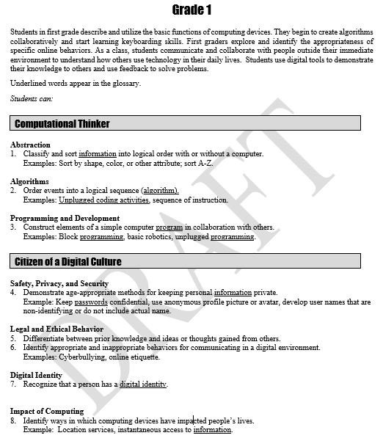
Organization of the Digital Literacy and Computer Science Course of Study
Strand
Topics
Content Standards
Strand
Topics
Content Standards
Notes:
Ashley
Within each grade, you will see the content standard strand. Under the strand, the topics that relate to that strand are listed. Then, under the topics, the content standards which relate to that topic, are numbered. Notice, in Grade 1, Computational Thinker is the strand, the first topic is Abstraction and content standard 1 is listed. Words that are listed in the glossary are underlined.

Slide 13
Overview for Grades 3-5
Grades 3 – 5 students will meet the following learning goals:
As Computational Thinkers, students will use problem-solving processes to understand how to write and debug an algorithm and to evaluate and create new informational representation, that successfully reframes an issue.
As Citizens of a Digital Culture, students will demonstrate an understanding of concepts involving safety and security, responsible use of technology, and the influence of technology on its users.
As Global Collaborators, students will collaboratively utilize intermediate research skills to create artifacts and use digital tools to communicate or exchange information.
As Computing Analysts, students will understand and use various computing devices strategically to solve a problem and accomplish a task in the most effective way.
As Innovative Designers, students will pioneer new solutions, products, and processes through design thinking and be familiar with the advantages and limitations of technology.
Notes:
Ashley
Just like the grade-band overview for Grades K – 2, the grade-band overview for Grades 3 – 5 contains the learning goals for Grades 3 – 5. In Grades 3-5, students explore diverse computing devices and digital tools while developing their problem-solving and computational thinking skills. These skills are necessary across the curriculum. Third- through fifth- grade students are able to engage in learning in ways that are methodical and imaginative. Students’ capabilities as problem solvers, innovators, and creators build on their K–2 experiences. When these learning goals are mastered in a student-centered environment, students will become proficient global citizens who are able to deal with a rapidly changing world. Alabama’s students will be able to solve both intermediate and complex problems and find desirable solutions for both local and global issues. The design thinking process will allow students to use logic, intuition, imagination, and systematic reasoning to explore what could be and create innovative solutions that benefit themselves and others.
Before we examine an overview of a grade, read this slide which contains the learning goals for Grades 3 – 5.

Slide 14
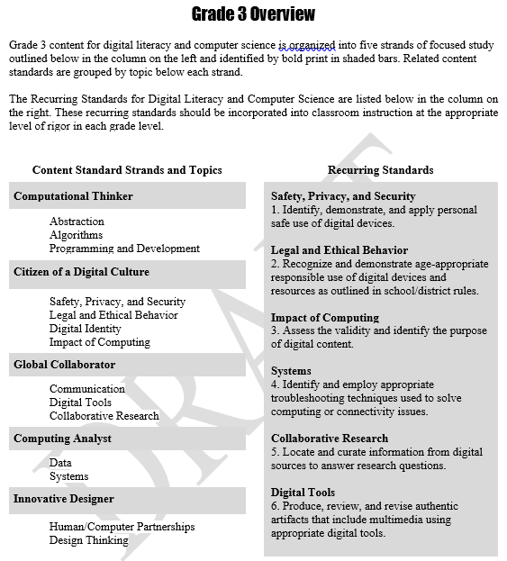
Strands
Topics
Notes:
Ashley
Again, just like Grades K – 2, after the grade-band overview, we see the grade-level overview. This is the Grade 3 Overview. Again, we see the Strands along with the topics that are related to those Strands. Notice on each grade-level overview, the recurring standards are listed.

Slide 15
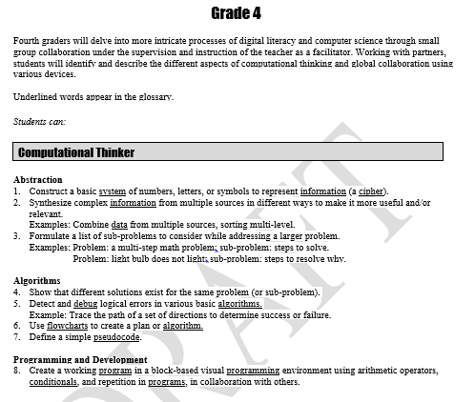
Strand
Topics
Content Standards
Notes:
Ashley
After each Grade-level Overview, we will see each Grade-level content standard. For example, this is Grade 4. The content standard strands and the topics listed with the content standards explained under each topic. Notice, in Grade 4, Computational Thinker is the strand, the first topic is Abstraction and content standard 1 is listed. Words that are listed in the glossary are underlined. To explain the organization of the 6 -12 standards, I am going to turn the presentation back over to Mark.

Slide 16
Overview for Grades 6-8
Grades 6 – 8 students will meet the following learning goals:
As Computational Thinkers, students will break problems into component parts, identify key pieces of information, and use that information to solve problems.
As Citizens of a Digital Culture, students will verbalize the impact of computing in a global society while safely, securely, ethically, and legally interacting with digital environments and protecting their digital identities.
As Global Collaborators, students will use appropriate digital tools to communicate data that informs, persuades, and entertains to collaborate with society locally and globally.
As Computing Analysts, students will utilize computing systems efficiently in the management and interpretation of data and information.
As Innovative Designers, students will leverage human and computer partnerships within a design process, creating useful and thoughtful solutions to problems.
Notes:
Mark
The Grade-band 6-8 and Grade-band 9-12 are organized using the same format as the grade-bands K-2 and 3-5. We are going to show you how these look and some of what is contained in these two grade-bands. You have a copy of the 2018 Alabama Course of Study: Digital Literacy and Computer Science in front of you. Students in Grades 6-8 are developing more independence as they seek their places in an increasingly digital and global society. Many of these students will begin developing their global online presence for the first time. In these grades, students are becoming proficient digital citizens, while continuing to build on a strong foundation in computer science principles. The goals of the content strands at this level demonstrate this balance. Notice, just like the Grade-bands K-2 and 3-5, next, we see the content standards for Grades 6-8 which encourage analysis, synthesis, and evaluation in digital literacy and computer science as themes within all areas of the academic curriculum. Furthermore, students in Grades 6-8 will work collaboratively to explore, employ, and develop digital tools.

Slide 17
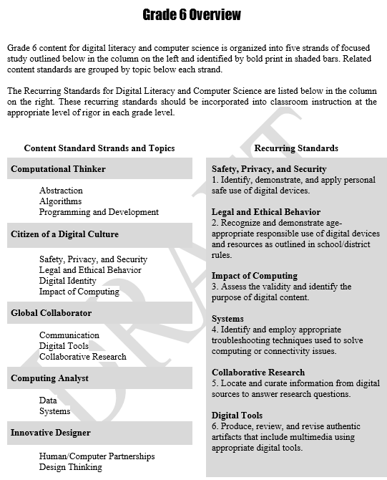
Strands
Topics
Notes:
Mark
Of course after the Grade-band Overview for Grades 6 - 8, we see the Grade 6 Overview. Just like the other grades and grade-bands, we see the Strands along with the Topics and of course, we see the Recurring Standards.

Slide 18
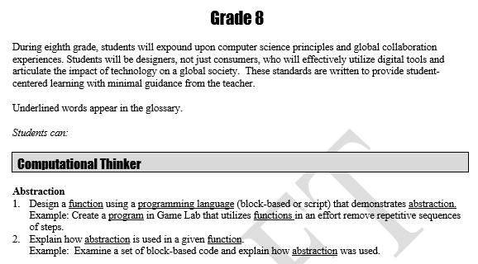
Strand
Topic
Content Standards
Notes:
Mark
Again, within each grade, you will see the content standard strands, topics, and the content standards explained under each topic. Notice, in Grade 8, Computational Thinker is the strand, the first topic is Abstraction and content standard 1 is listed. Words that are listed in the glossary are underlined.

Slide 19
Overview for Grades 9-12
Grades 9 – 12 students will meet the following learning goals:
As Computational Thinkers, students will demonstrate how to make complex situations simple, developing algorithms that define the systematic processes needed to solve problems encountered in life.
As Citizens of a Digital Culture, students will demonstrate an understanding of concepts involving safety and security, responsible use of technology, and ways it can influence people through social interactions.
As Global Collaborators, students will utilize digital tools to collaborate and communicate with others to solve problems presented in today’s technical world.
As Computing Analysts, students will analyze and create solutions to problems and challenges presented in the use of computer systems and data.
As Innovative Designers, students make decisions and create solutions using the various digital tools available in today’s technical environments.
Notes:
Mark
Students in Grades 9-12 experience significant growth and development as they assume more complex responsibilities. They broaden their perspective regarding the importance of existing and developing technologies and have an understanding of the scope of technology in today’s world. As students progress through their high school years, they are able to address a variety of problems on a range of topics in a logical manner. Technology offers students an efficient means for solving many types of problems.
Many students have opportunities to interact with people whose backgrounds are different from their own because of the cultural and ideological diversity of a technologically advanced global society. As the use of technology brings humankind closer together, concepts and skills utilizing digital literacy and computer science will assist students in becoming productive adults.

Slide 20
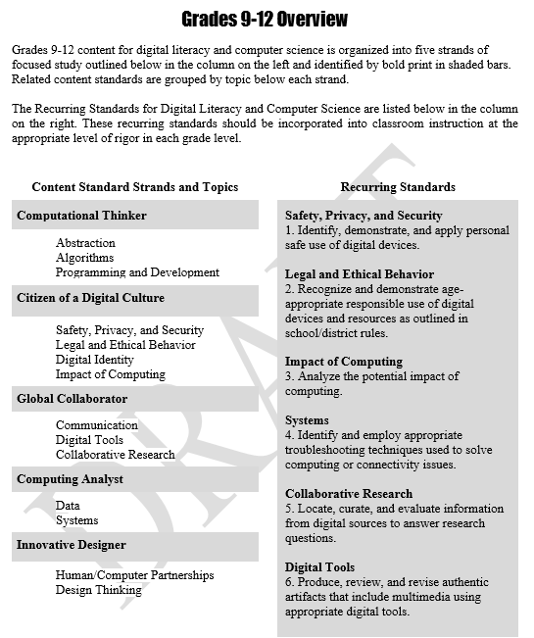
Strands
Topics
Notes:
Mark
Grades 9 – 12 Overview is two pages because the high school standards are not separated into individual grade-levels, K – 8 is. After the learning goals are explained then the second page of the Grades 9 – 12 Overview describes the Content Standard Strands and Topics, along with the Recurring Standards.

Slide 21
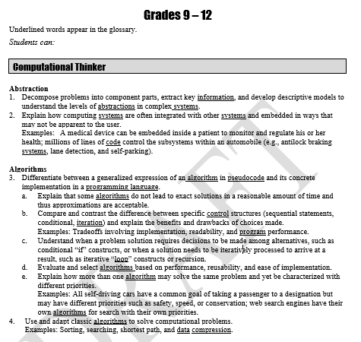
Strand
Topic
Content Standards
Notes:
Mark
The content standards for Grades 9 – 12 are next. Again, you will see the content standard strands and the topics listed with the content standards explained under each topic. Notice, in Grades 9 – 12, Computational Thinker is the strand, the first topic is Abstraction and content standard 1 is listed. Words that are listed in the glossary are underlined.

Slide 22
Cross Curricular Implementation: 2nd Grade Example
Content Standards
ELA: 22 Writing | Write opinion pieces in which they introduce the topic or book they are writing about, state an opinion, supply reasons that support the opinion, use linking words (e.g., because, and, also) to connect opinion and reasons, and provide a concluding statement or section. [W.2.1]
Math: 10 Measurement and Data | Draw a picture graph and a bar graph (with single-unit scale) to represent a data set with up to four categories. Solve simple put-together, take-apart, and compare problems using information presented in a bar graph.
Digital Literacy and Computer Science: 1 Abstraction | Create and sort information into useful order using digital tools. Examples: Sort data spreadsheets A-Z, simple filters, and tables.
Cross Curricular Activity: Students will write an opinion piece about a certain choice in their community or school. For example, whether or not students should have uniforms. Students will collect votes on whether or not classmates agree with their position. Using a digital tool, such as Google Sheets, students will compile this collected data and share with a small group.
22
Notes:
Ashley
This is an example of how DLCS Standards can be implemented across the curriculum. Now I am going to turn the presentation over to Mark to give an example of how to implement the DLCS COS across the curriculum in High School.

Slide 23
Cross Curricular Implementation: High School Example
Content Standards
ELA 12.24 Writing | Use technology, including the Internet, to produce, publish, and update individual or shared writing products in response to on going feedback, including new arguments or information. [W.11-12.6]
SS 12.9 US Government | Trace the impact of the media on the political process and public opinion in the United States, including party press, penny press, print media, yellow journalism, radio, television, and electronic media.
Digital Literacy and Computer Science: 24 Creative Communication | Compare and contrast internet publishing platforms, including suitability for media types, target audience, and feedback mechanism.
Cross Curricular Activity: In small groups, students will choose two policy issues, one at the local or school level, the other at a regional or national level. Students will organize a media campaign to rally support for one side of these issues, including writing copying and creating digital media. Students will determine the best media platforms for each issue, dependent on size, scope, and demographics of the target audience. Issues of media narrative, propaganda, and sensationalism should be addressed and discussed in campaign outline documents.
23
Notes:
Mark
This is a high school example of how DLCS Standards can be implemented across the curriculum.

Slide 24
Appendices
International Society for Technology Education (ISTE) Standards for Students
Progression of Computer Science Teachers Association (CSTA) K – 12 Computer Science Standards, Revised 2017
K-12 Computer Science Framework
Notes:
Mark
The DLCS COS committee wanted teachers to have quick access to the ISTE Standards for Students, the Progression of the CSTA K-12 Computer Science Standards, and the K12 Computer Science Framework. These documents are in the Appendices at the end of the course of study, along with a glossary and bibliography.

Slide 25
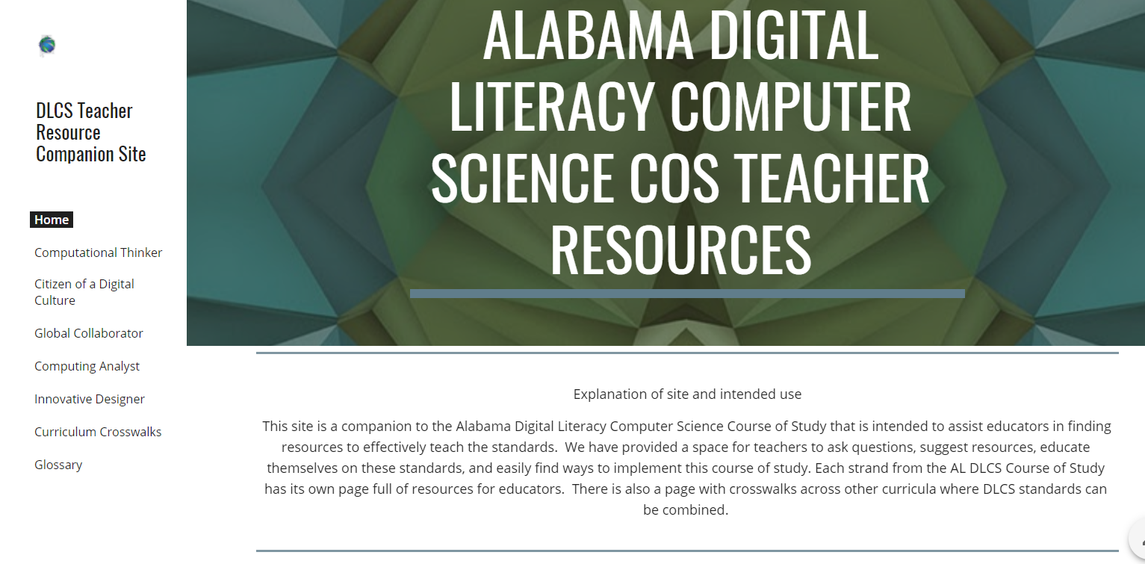
Available Resources
Digital Literacy and Computer Science Course of Study Companion website: https://alex.state.al.us/dlcs
ALEX lesson plans, Code.org, CS for All Teachers
Notes:
Ashley
Available resources to LEAs to help implement the 2018 DLCS Course of Study.

Slide 26
2018 Digital Literacy and Computer Science Course of Study
Thank You!
Notes:
Mr. Hopkins
Thank you so much for your time.

